Slide 1

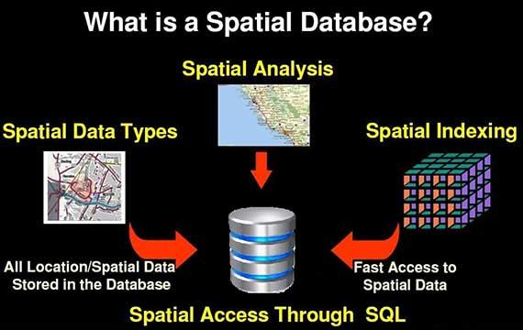
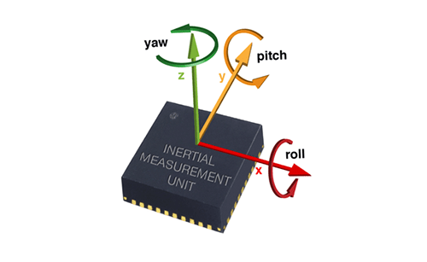
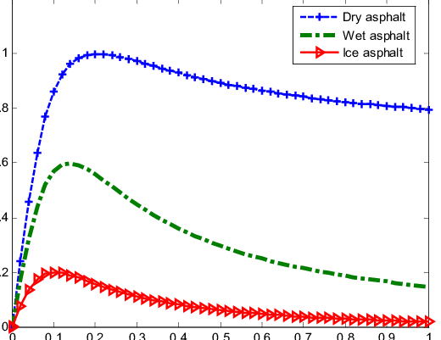
Database Management(DBM) – Architecture and Operation
Intelligent Vehicles and Systems Group,
Department of Mechanical Engineering，
The Pennsylvania State University
03/13/2020
Liming Gao
Adaptive Global Sliding Mode Control Strategy for the Vehicle Antilock Braking Systems - Scientific Figure on ResearchGate. [accessed 4 Feb, 2020]

Slide 2
Why we need a database? File systems V.S. DBMS
Manage the data in a robust and efficient manner as the volume of data and the number of users grow.
Data independence
Efficient data access
Data integrity and security
Data administration
Concurrent access and crash recovery
Reduced application development time

Slide 3

The complexity of the data we are trying to process requires a multi-database architecture
Data source: real word features, simulation features, online dataset
Noisy and error filled data from specified vehicle and specific time in a cumbersome format
Noisy and error filled data from specified vehicle and specific time in a shareable format
Clean data from specified vehicle and specific time in a shareable format
Clean data from specified vehicle and specific location in a shareable format
aggregated data at a specific location in a shareable format
Raw-Data database
Processed-Data database
Map Database
Raw Data
User application
Sensors
API
Server
Data cleaning/processing
Data processing
Client
Extract and aggregate data step by step
Data size decrease progressively

Slide 4

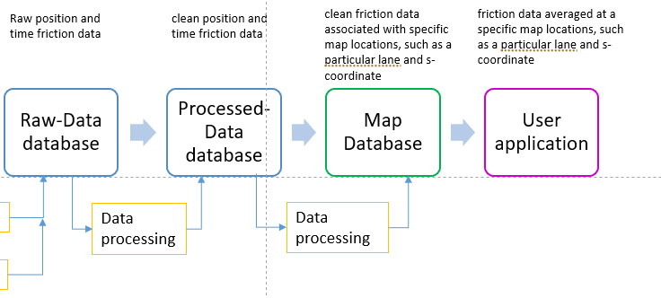



For NSF Project, Simulation world, traffic, and ego vehicle
Data elements including speed, lane, from each vehicle at various times and location (10Hz)
Friction noise model
Driven position noise
Traffic Database
Friction estimate
(50Hz)
Historical Friction
Contextual Info. Database
Vehicle model
F
f
Road Generator
Vehicle model
2cm*2cm grid for 31m*30km* 5min for 8 hours
With friction and contexture(Temperature, Roughness, wetness, pavement type, slide number)
Store them as images?
Sensors
API

Slide 5
Here is an example for our NEXTCAR project
.bag files from Volvo truck and mapping van
clean position and time fuel consumption data
clean fuel consumption data associated with specific map locations, such as a particular lane and s-coordinate
Fuel consumption rate data averaged at a specific map locations, such as a particular lane and s-coordinate
Raw position and time fuel consumption data
Raw-Data database
Processed-Data database
Map Database
Raw Data
User application
Server
Data processing
Data processing
Client

Slide 6
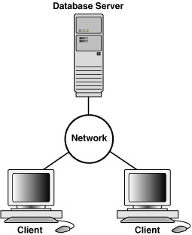
Client/Server and Multi-database Architecture
Raw-Data database
Processed-Data database
Map Database
Raw Data
User application
Server
Data processing
Data processing
Client
The server runs the PostgreSQL database software and handles the data consistency and security.
The client runs the database application, for example, a MATLAB data access and processing program, map query.
Data processing can be done using MATLAB at client.
The information in map database can be accessed by public client
Image source: Wikimedia Commons

Slide 7
Client/Server and Multi-database Architecture
Raw-Data database
Processed-Data database
Map Database
Raw Data
Public User
Server
Data processing
Data processing
Client
The client runs the database application, for example, a MATLAB data access and processing program.
The server runs the PostgreSQL database software and handles the data consistency and security.
Data processing can be done using MATLAB at client.
Use client to process/access large size data (e.g. images) is not recommended if the network is slow or expensive.
Image source: Wikimedia Commons

Slide 8
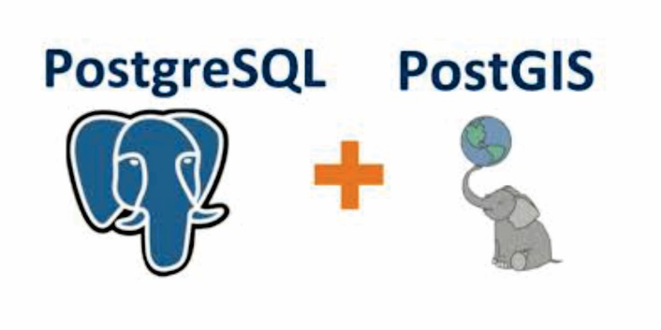
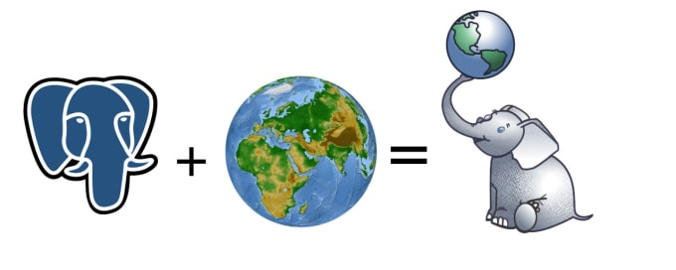
We use PostgreSQL + PostGIS Database Platform
PostgreSQL:
“The world's most advanced open source database”
Object-relational database management system
Supports a large part of the SQL standard
Can be extended by the user
PostGIS:
A spatial database extender for PostgreSQL.
Adds more spatial data types, such as geometry, geography, raster, to PostgreSQL database.
Adds more operations, functions and index enhancement to the spatial data types.
Allow you to perform spatial queries based on latitude and longitude coordinates.

Slide 9
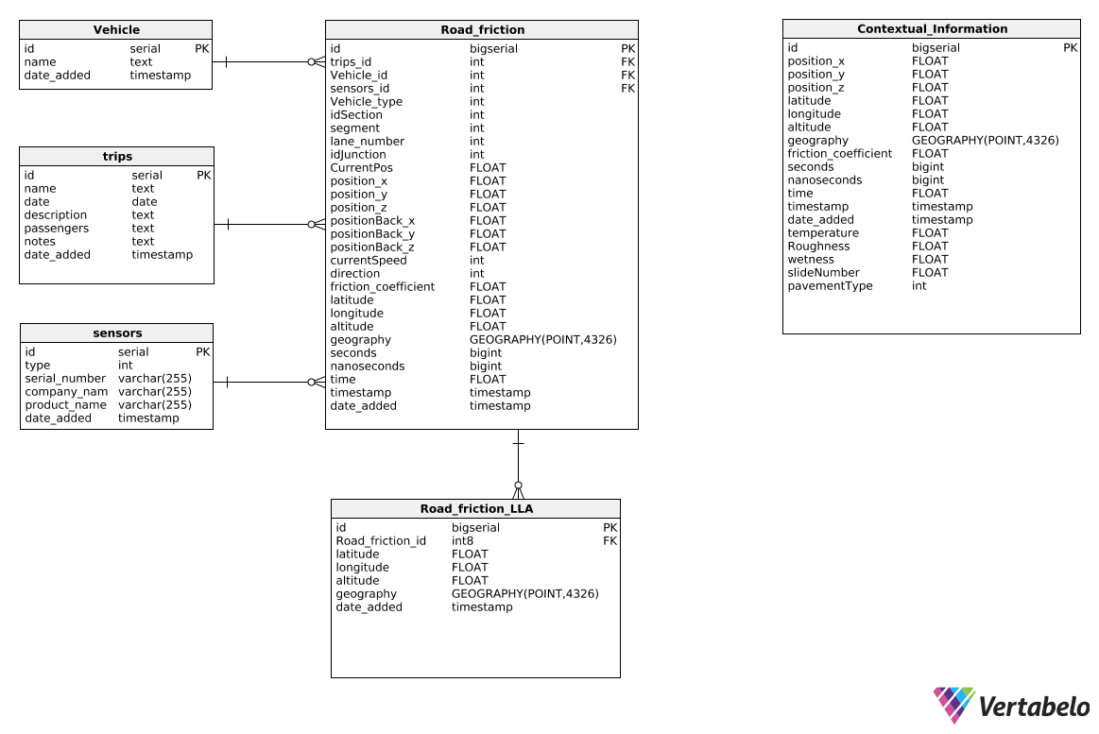
Raw-data Database Schema
Entity-Relationship model for traffic Simulation raw data
Traffic Simulation
Contextual Info.

Slide 10
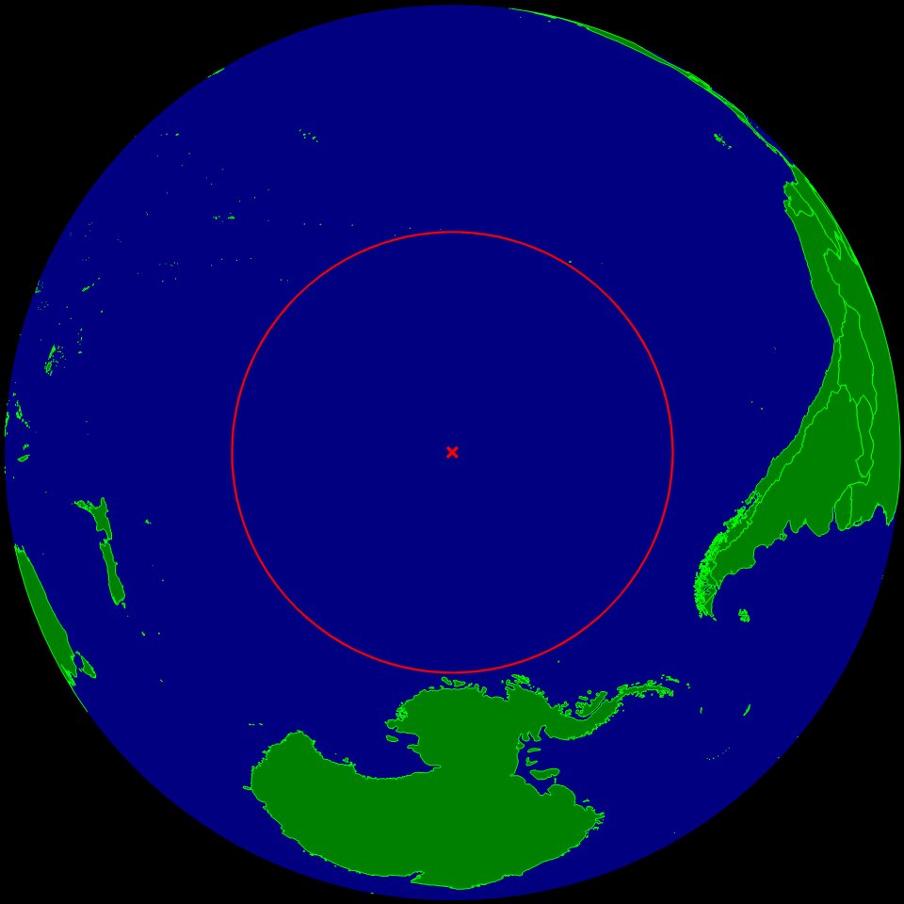
We put the coordinate origin of simulation environment to the “Point Nemo”
“The oceanic pole of inaccessibility (48°52.6′S 123°23.6′W) , known as "Point Nemo", is the place in the ocean that is farthest from land. It lies in the South Pacific Ocean.
Nemo being Latin for “no one” . it lies more than 1,400 nmi (2,593 km) from the nearest landmass.”
------ From Wikipedia, the free encyclopedia

Slide 11
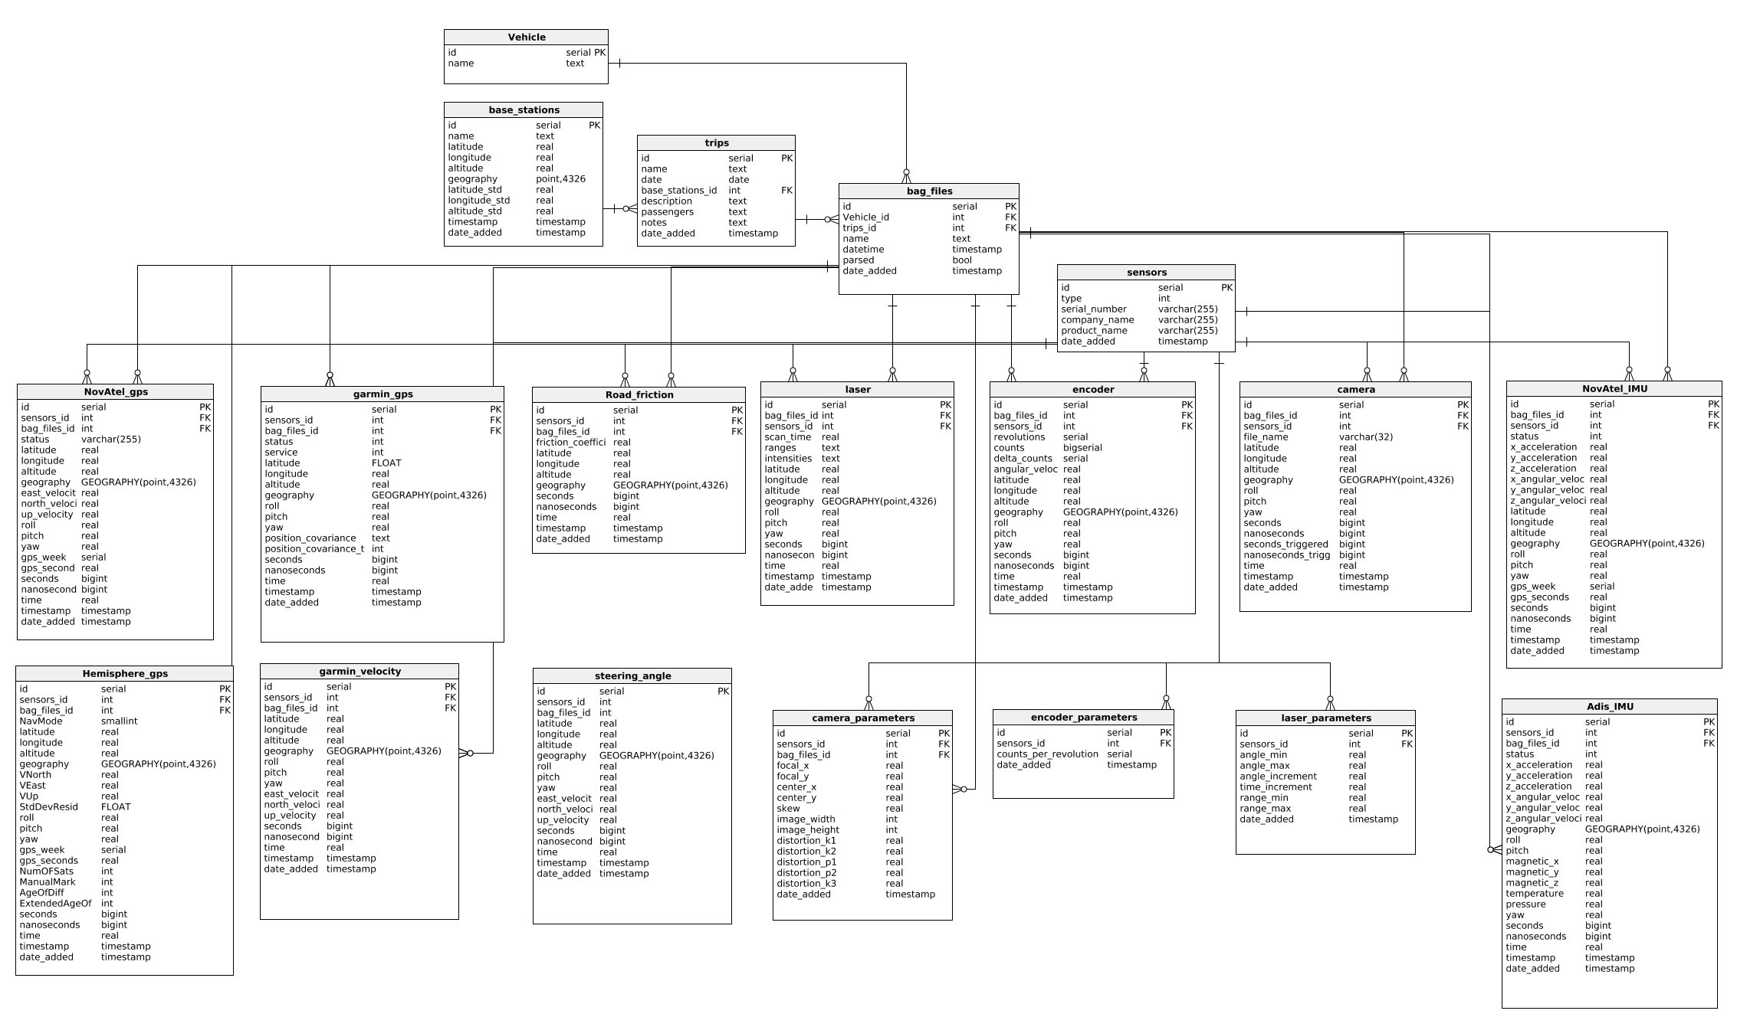
Raw-data Database Schema
Entity-Relationship model for mapping van

Slide 12
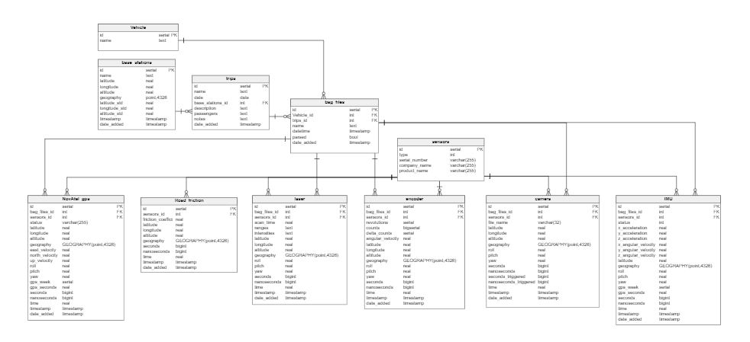
Processed-data Database Schema(draft)
The schema may keep updating when we processing the data

Slide 13
Mapping Database Schema(idea)
Multiple layer Entities:
Road_network(id, name, start_point, end_point, lane_number, width, road_type, time_collected, time_updated )
Lane(id, Road_network_id, friction_id, center_latitude, longitude, altitude, roll, pitch, yaw, width, lane_type, speed_limit, left_lane, right_lane, time_collected, time_updated)
Trraffic_light(id, lane_id, stopbar_latitude, longitude, altitude, time_collected, time_updated)
Stop_sign(),
Road_sign()
Friction(id, coefficient, … time_collected, time_updated)
Traffic
Light-timing
Construction
Layer1,
topology map
Layer2,
Edges
Layer3,
S-coordinate features
Layer4, time-based s-coordinate features

Slide 14
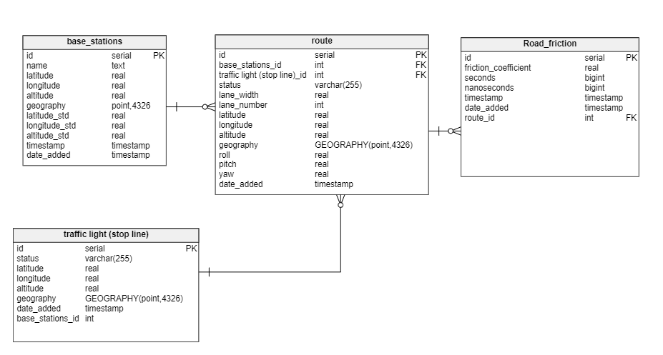
Map Database Schema(draft)

Slide 15
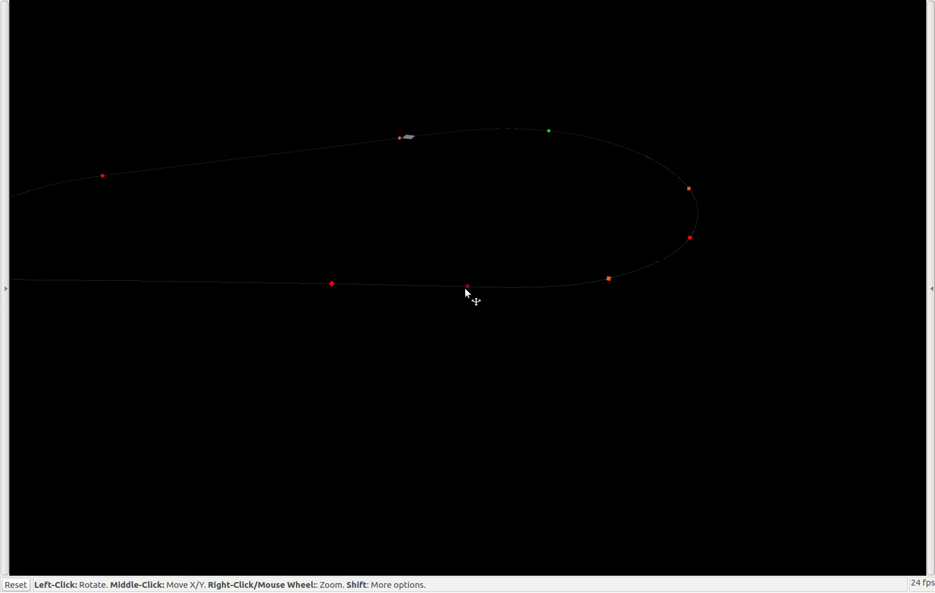
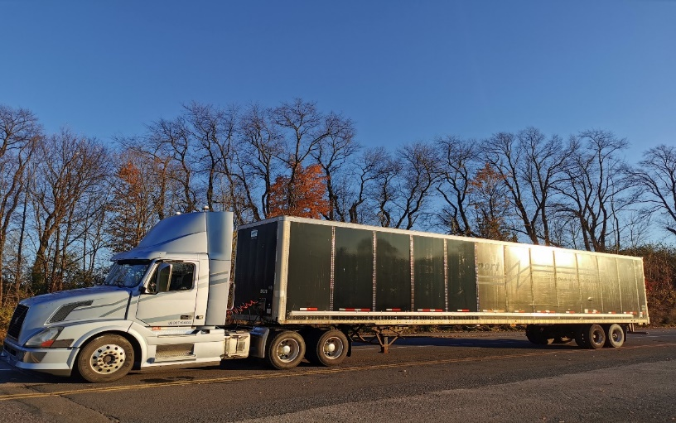
Test track map application
We have route start/end point, lane center coordinate, lane RPY, and traffic light location
Map
Nearest query
Vehicle position

Slide 16
The following slides discuss the details of converting raw data into the raw data database
Noisy and error filled data from specified vehicle and specific time in a cumbersome format
Noisy and error filled data from specified vehicle and specific time in a shareable format
Clean data from specified vehicle and specific time in a shareable format
Clean data from specified vehicle and specific location in a shareable format
aggregated data at a specific location in a shareable format
Raw-Data database
Processed-Data database
Map Database
Raw Data
Client Application
Server
Data processing
Data processing
Client

Slide 17
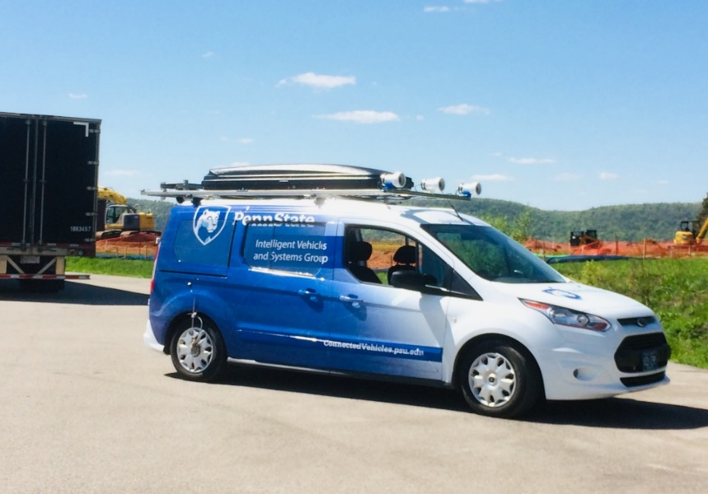
Raw Data are Collected by Mapping van, P1
Image source: Wikimedia Commons
Mapping Van uses ROS to collect data. The raw data format is .bag files.
P1’s raw data format is .mat files.

Slide 18
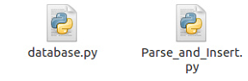
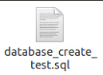
Convert and Import the Raw data into database at server: parsing procedures
Step 0: Setup the database structure using .sql file.
Step1: Copy the raw data from vehicle to database server.
Step2: Parse .bag data into to .csv/.txt data for each topic/sensors. However, for images, save them into .jpg/.gif whose file path is encoded by md5 hash values.
Step3: Import .csv/.txt format raw data into database. Import images md5 file path into database rather than file itself.
Alter the database structure using .sql file.
.bag files
.mat files
Python script to parse .bag files
.csv .txt
.jpg files
Database
Setup database using .sql file
Outputting .csv .txt files is optional

Slide 19
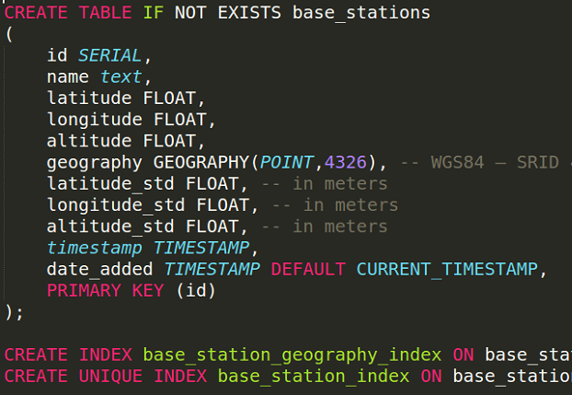
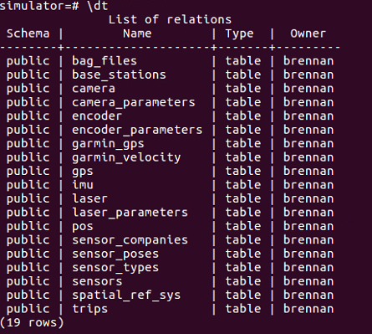
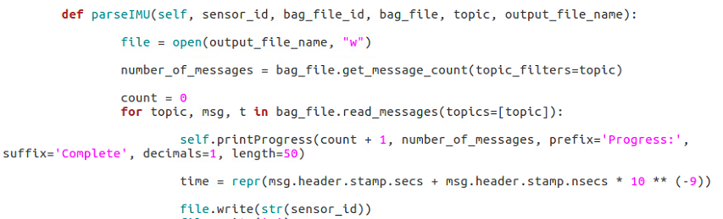
Convert and Import the Raw data into database at server: code and tables screen shot
The relations/tables in the raw data database

Slide 20
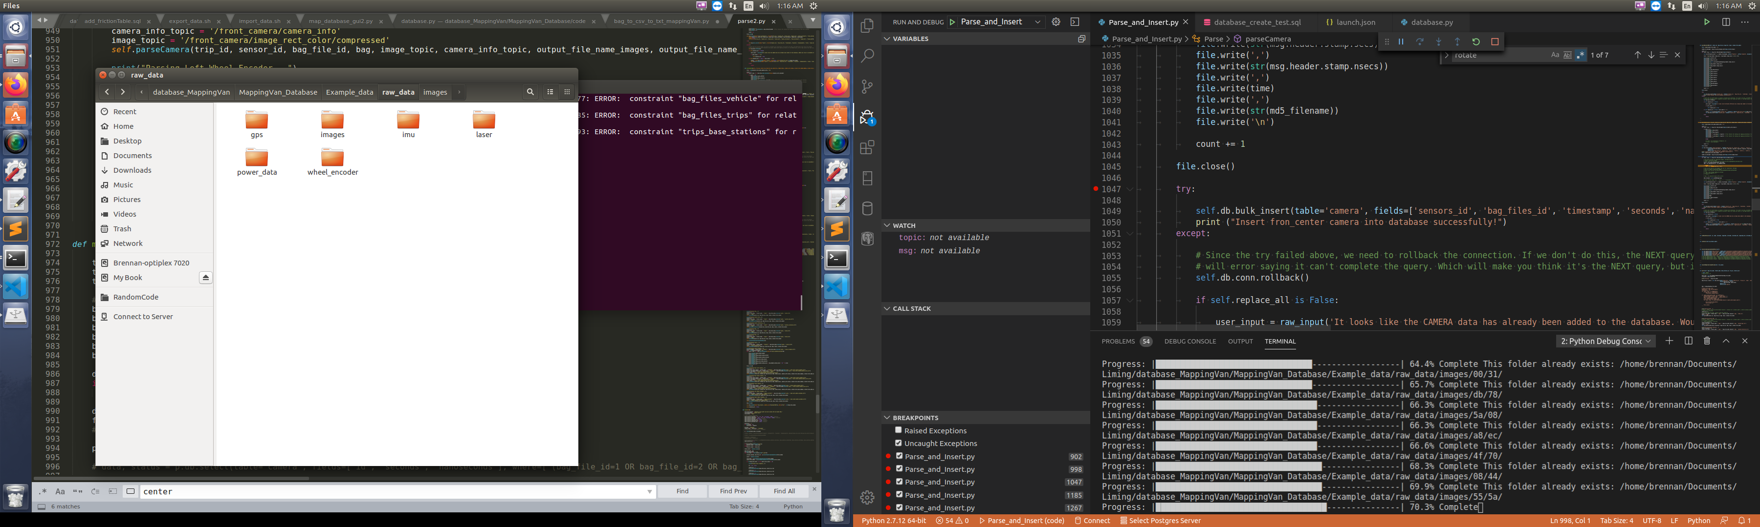
Convert and Import the Raw data into database at server: code and process screen shot
The images and csv files
The parsing process visualization

Slide 21
The following slides discuss the details of converting raw data database into the processed database
Noisy and error filled data from specified vehicle and specific time in a cumbersome format
Noisy and error filled data from specified vehicle and specific time in a shareable format
Clean data from specified vehicle and specific time in a shareable format
Clean data from specified vehicle and specific location in a shareable format
aggregated data at a specific location in a shareable format
Raw-Data database
Processed-Data database
Map Database
Raw Data
Client Application
Server
Data processing
Data processing
Client

Slide 22
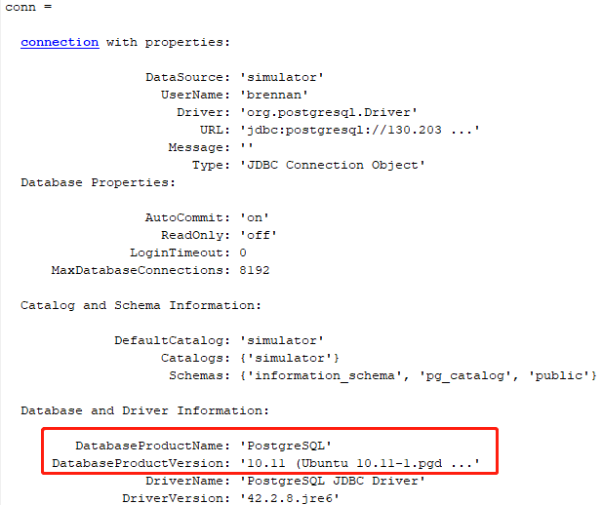
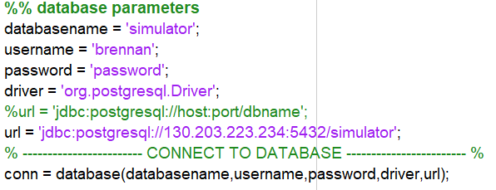
Connect to server database at client using MATLAB
Step 1. Install PostgreSQL 10 at your client computer.
Step 2. Install PostGIS 2.5 using installed Stack Builder 4.2.0
Step 3. Install JDBC driver so that you can connect to the database using MATLAB
Step 4. Install the PSU network VPN.
Step 5. Connect to the internet via PSU VPN. If your client computer connects to internet on campus internet, this step is optional.
Step 6. Run MATLAB at client to connect to database.
For more details of step1-5, refer to the database tutorial
Example:
Connect

Slide 23
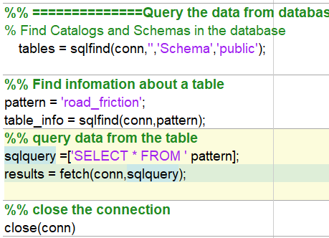
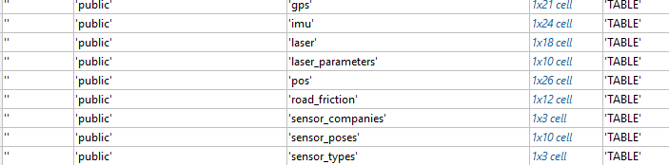
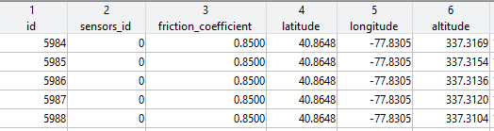
Query data from raw database, process them, and insert/update them into processed database
Query data from raw database:
use sqlfind(conn,’’) to get the structure about a database and table ;
use fetch(conn, sqlquery) to get the data from a table
20 tables in the database
Partial data in the road_friction table

Slide 24
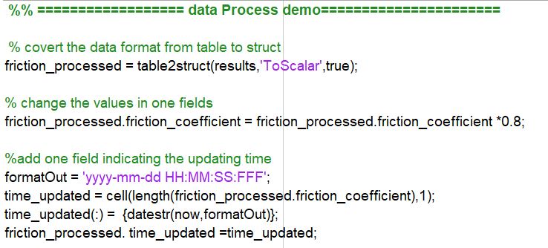
Query data from raw database, process them, and insert/update them into processed database
Query data from raw database
Process the data, such as, time aligned, filter data, data fusion, lane detection, and etc..
Example:
Update data values, add/remove fields

Slide 25
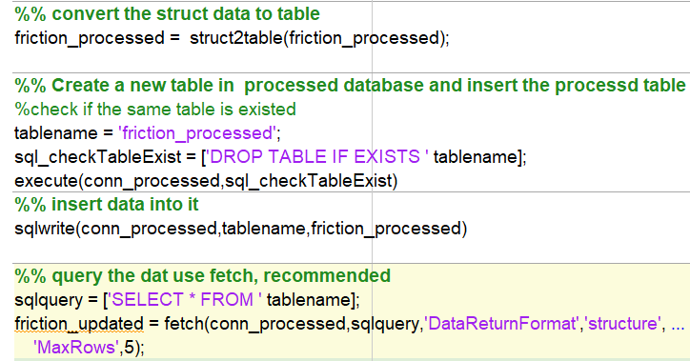
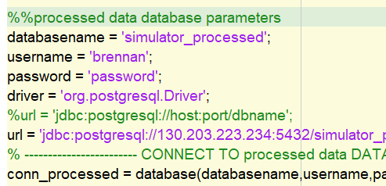
Query data from raw database, process them, and insert/update them into processed database
Query data from raw database
Process the data
Import the processed data into processed data Database:
1. Connect to processed data
2. Create a table and insert data
3. !!! Once a table structure is confirmed. Do NOT drop it, just append new data into it or update existed!!
Example code:

Slide 26
The following slides discuss the details of converting raw data database into the processed database
Noisy and error filled data from specified vehicle and specific time in a cumbersome format
Noisy and error filled data from specified vehicle and specific time in a shareable format
Clean data from specified vehicle and specific time in a shareable format
Clean data from specified vehicle and specific location in a shareable format
aggregated data at a specific location in a shareable format
Raw-Data database
Processed-Data database
Map Database
Raw Data
Client Application
Server
Data processing
Data processing
Client

Slide 27
Ensure Database Security via technological security and physical security.
Technological security
Backup the database each two days or under other necessary circumstance, and sync to PSU box.
Strict Authentication: demonstrating who you are. E.g. Email verification code required.
Set Authorization to different user. E.g only super user can drop a table. Guest can only query public data.
…
Physical security and security policies
Restricting access to the server room (Reber 320)
Change password(server pwd, database pwd) each semester
Do not share login information with irrelevant person, including your best friends.
…

Slide 28
Cloud database
It is good but expensive
Notes:
To determine a fix (position) and time, GNSS receivers need to be able to track at least four satellites. This means there needs to be a line of sight between the receiver’s antenna and the four satellites.
Receivers vary in terms of which constellation or constellations they track, and how many satellites they track simultaneously.
For each satellite being tracked, the receiver determines the propagation time. It can do this because of the pseudorandom nature of the signals. To illustrate, refer to Figure 17, which shows the transmission of a pseudorandom code, a series of zeroes and ones. Since the receiver knows the pseudorandom code for each satellite, it can determine the time it received the code from a particular satellite. In this way, it can determine the time of propagation.

Slide 29
To do list
Write more database class function for MATLAB so that user who do not know SQL can query and update data easily.
Setup the database security protocol
Notes:
To determine a fix (position) and time, GNSS receivers need to be able to track at least four satellites. This means there needs to be a line of sight between the receiver’s antenna and the four satellites.
Receivers vary in terms of which constellation or constellations they track, and how many satellites they track simultaneously.
For each satellite being tracked, the receiver determines the propagation time. It can do this because of the pseudorandom nature of the signals. To illustrate, refer to Figure 17, which shows the transmission of a pseudorandom code, a series of zeroes and ones. Since the receiver knows the pseudorandom code for each satellite, it can determine the time it received the code from a particular satellite. In this way, it can determine the time of propagation.

Slide 30
Thank you!

Slide 31
Images data management: file path store vs. binary data store
Details need to be presented

Slide 32
Hash value is used to manage picture data
To be presented.

